Slide 1
Optimize Your EMS to Support Chemical and Waste Management
October 30, 2018
Matt Conway, CHMM, CSP

Slide 2

System
“a way of doing things”
https://dictionary.cambridge.org/us/dictionary/english/system
“a regularly interacting or interdependent group of items forming a unified whole”
https://www.merriam-webster.com/dictionary/system
Management System
“set of interrelated or interacting elements of an organization to establish policies and objectives and processes achieve those objectives”
ISO 14001:2015 – 3.1.1

Slide 3
EMS
“a set of processes and practices that enable an organization to reduce its environmental impacts and increase its operating efficiency”
https://www.epa.gov/ems
“part of the management system used to manage environmental aspects, fulfil compliance obligations, and address risks and opportunities”
ISO 14001:2015 – 3.1.2

Slide 4
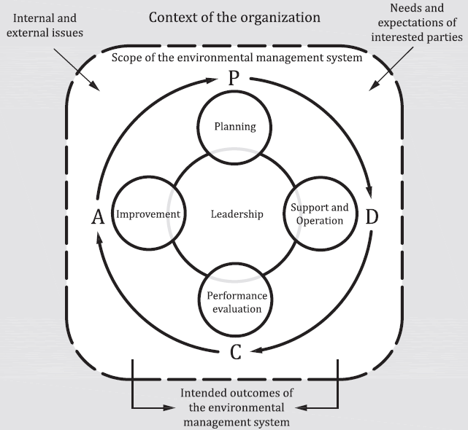
Plan, Do, Check, Act
Plan: What are we going to do?
Do: Let’s do what we planned.
Check: Did we meet our expectations
or requirements?
Act: Are changes needed or
can we do it better?
ISO 14001:2015 – 0.4

Slide 5
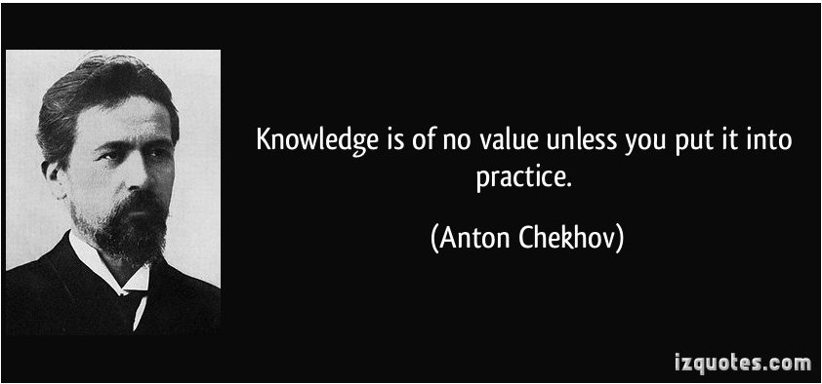

Slide 6
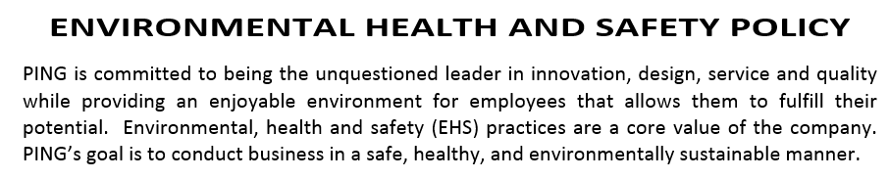
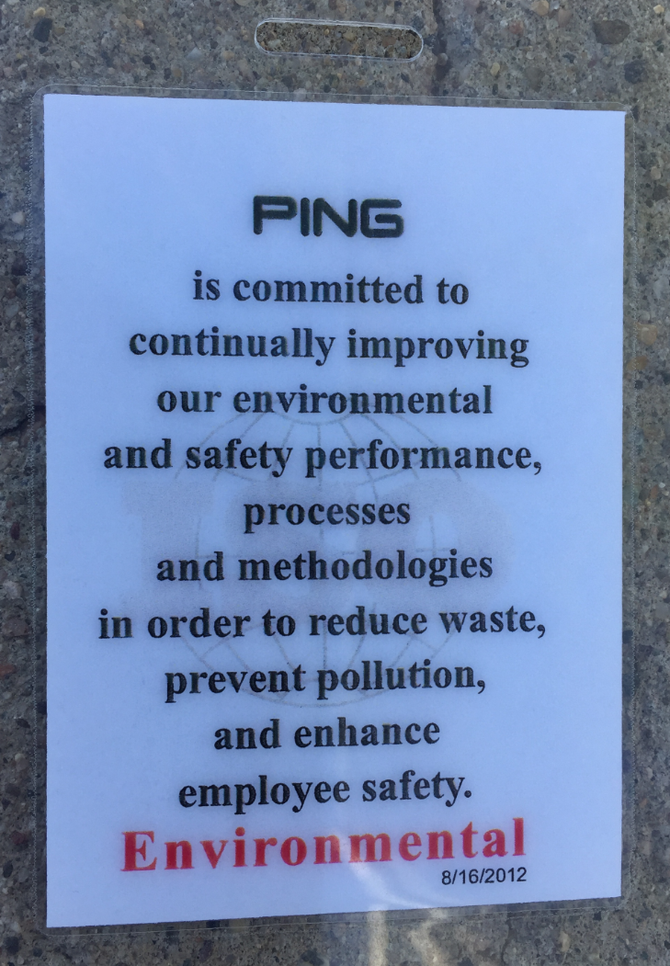
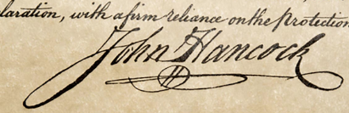
PLAN - Policy
High-level commitment
All activities should support the policy
Buy-in
Make it easy to understand

Slide 7
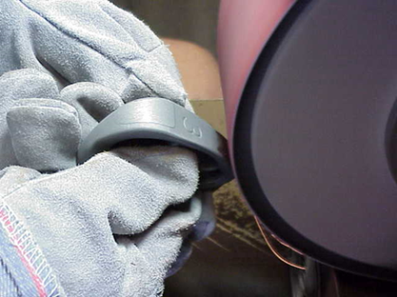
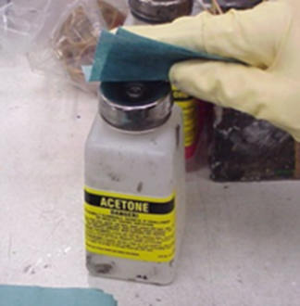
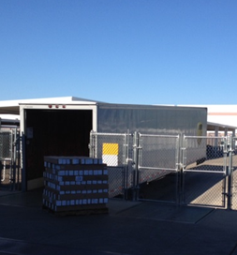
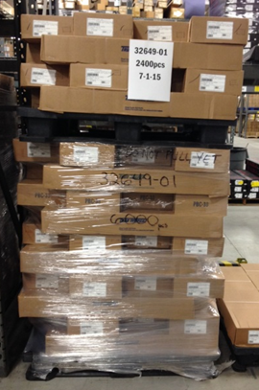

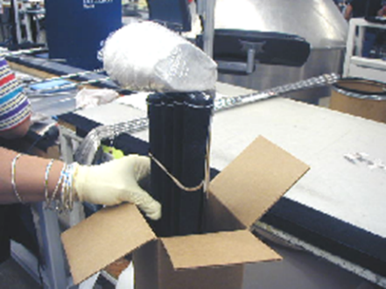
PLAN – Review Operations
Inputs and Outputs or Aspects and Impacts

Slide 8
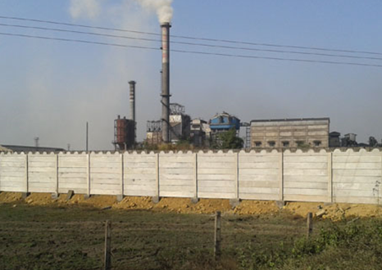


PLAN – Review Operations

Slide 9
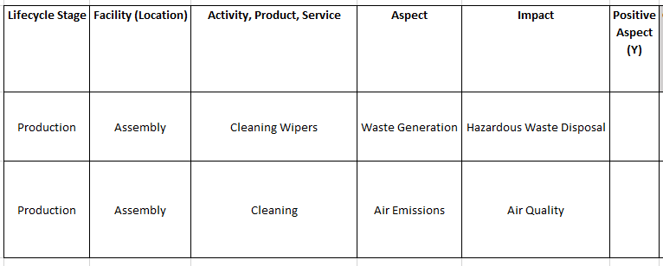
PLAN – Review Operations
List activities, aspects (inputs) and impacts (outputs)

Slide 10




PLAN – Compliance Obligations

Slide 11




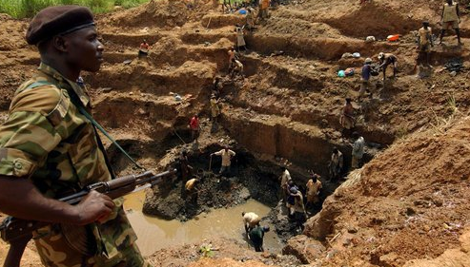


Slide 12
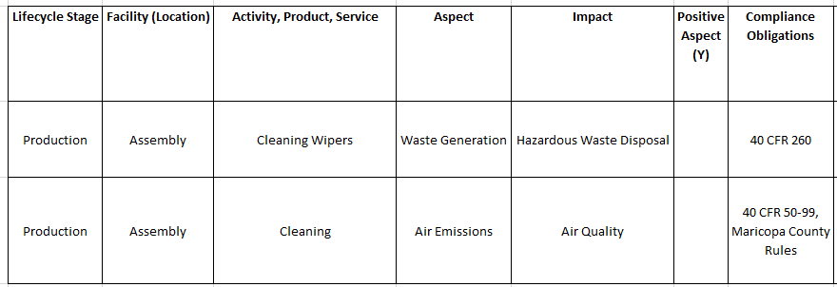
PLAN – Compliance Obligations
Take compliance into account in your evaluation

Slide 13
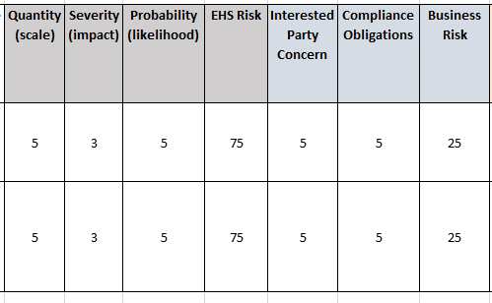
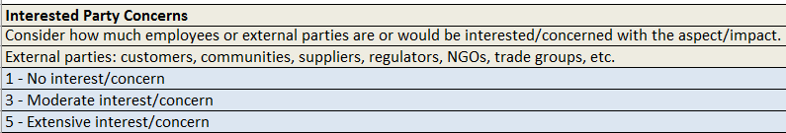
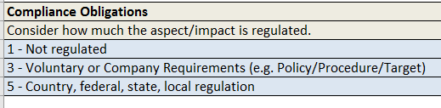
PLAN - Evaluate
Rank activities, aspects (inputs) and impacts (outputs)
Define criteria
Quantitative or qualitative

Slide 14
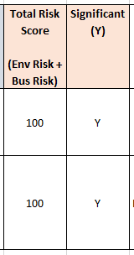
PLAN - Evaluate
Identify activities/impacts that are significant
Why?
Develop Controls
ID Additional Risks and Opportunities
IMPROVE

Slide 15
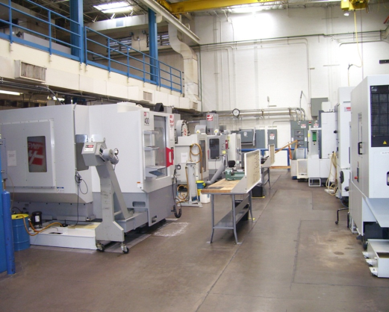
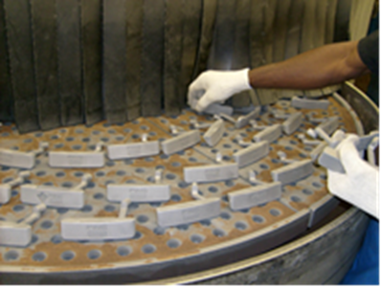

PLAN - Evaluate
Identify activities/impacts that are significant
Operational
Regulatory
Other Risks
Everything can’t be significant

Slide 16
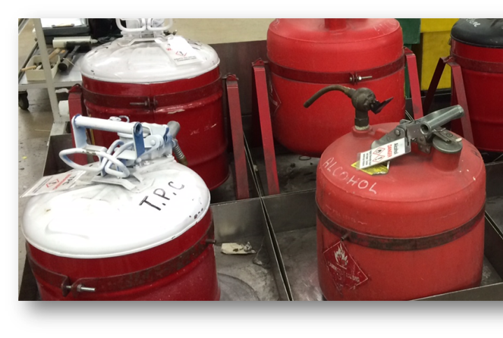


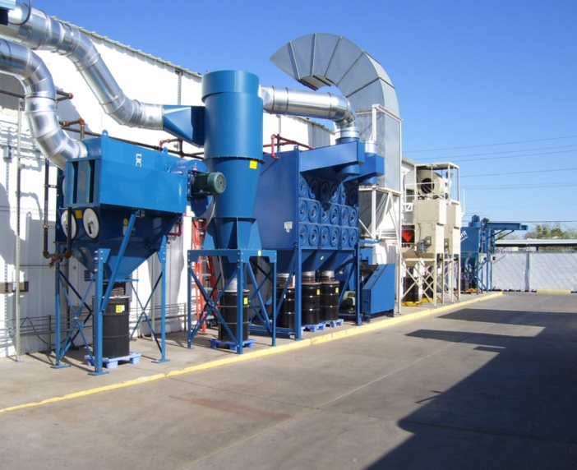
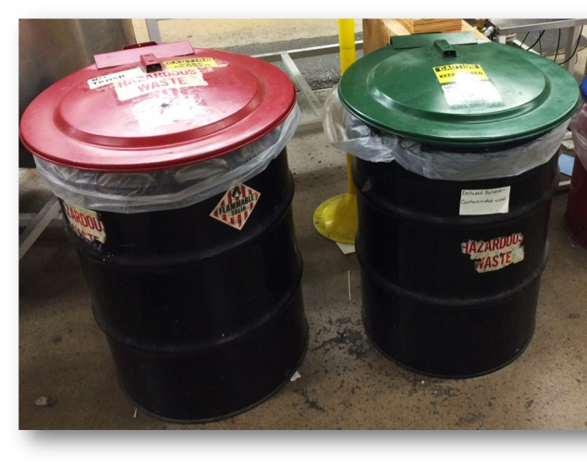
DO – Controls
Physical

Slide 17
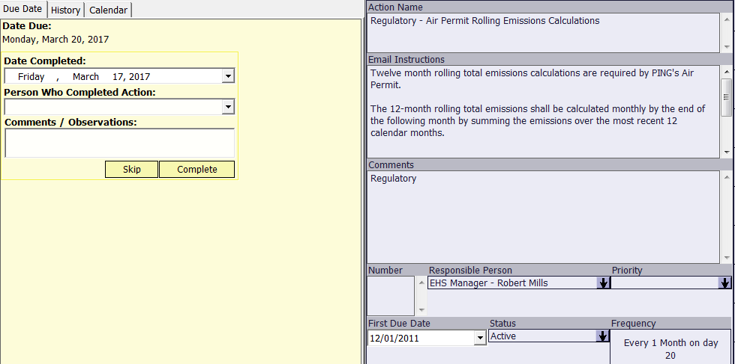
DO – Controls
Scheduling Tasks

Slide 18
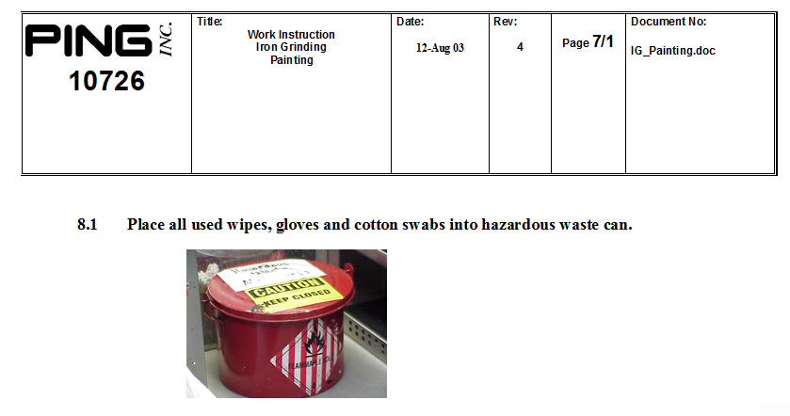
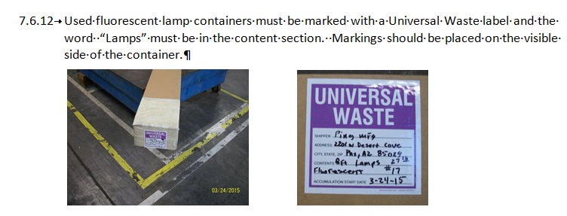
DO – Controls
Procedures/Instructions

Slide 19
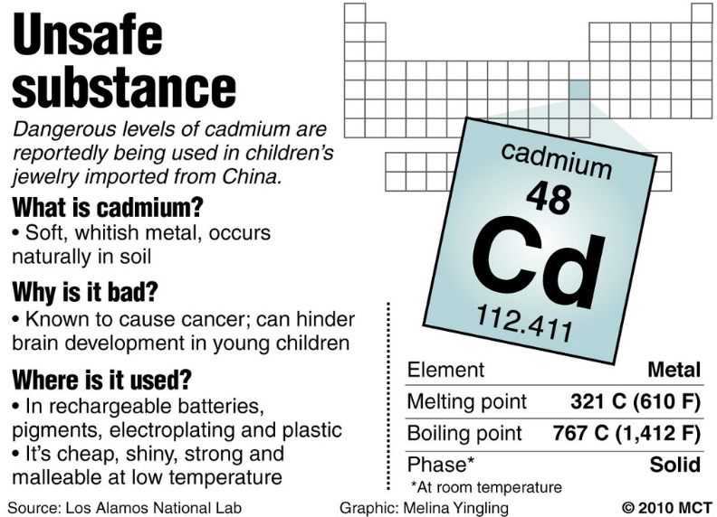


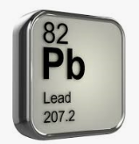
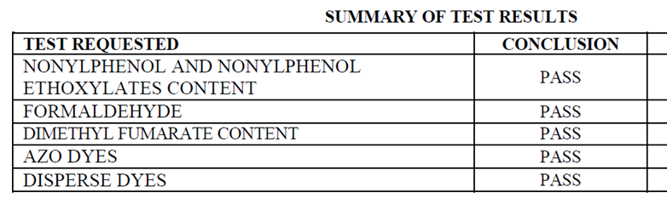
DO – Controls
Upstream Processes
Restricted Substances

Slide 20
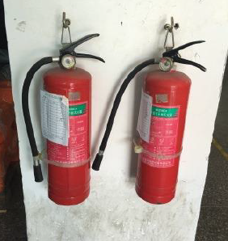
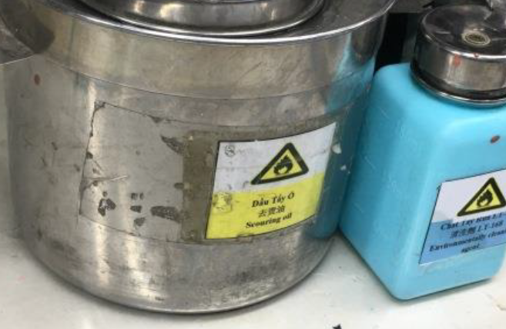
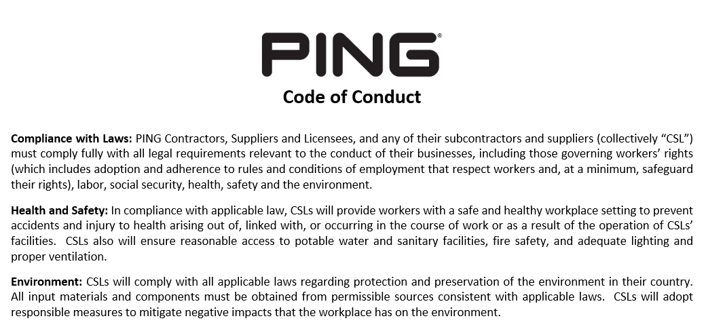
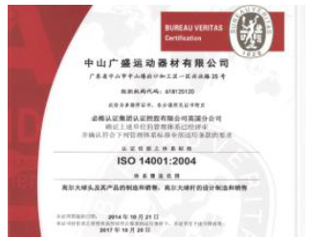
DO - Controls
Upstream Processes
Supply Chain

Slide 21
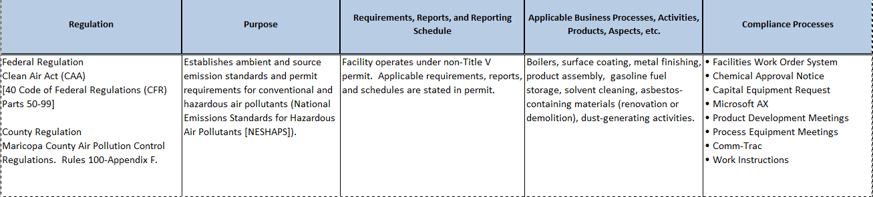
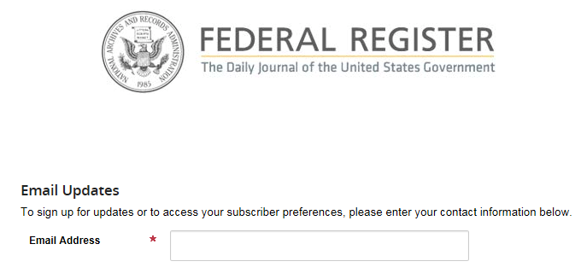


DO - Controls

Slide 22
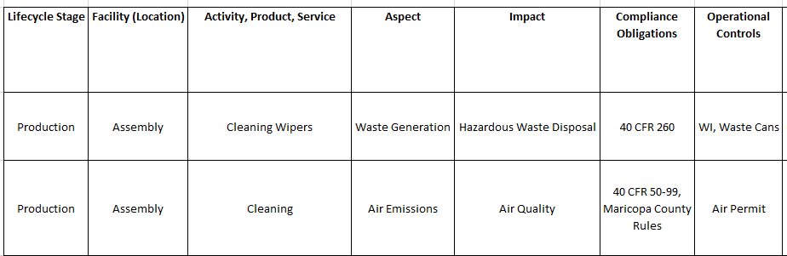
DO - Controls
Take controls into account in your evaluation

Slide 23
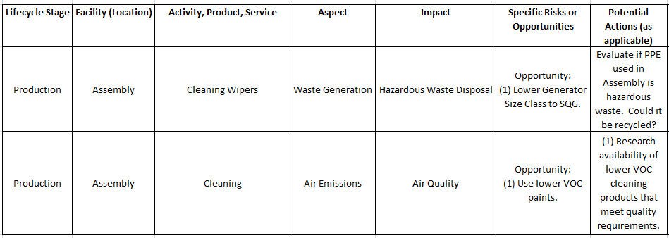
DO – Identify Risks/Opportunities

Slide 24
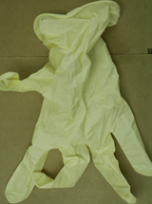

DO – Establish Objectives/Action Plans
Waste Generation Significant
Opportunity: Lower generator status
Objective: Achieve a 90% diversion rate of waste in 5 years
Is PPE not hazardous – then maybe lower status (supports the opportunity)
If recyclable – supports diversion rate objective

Slide 25
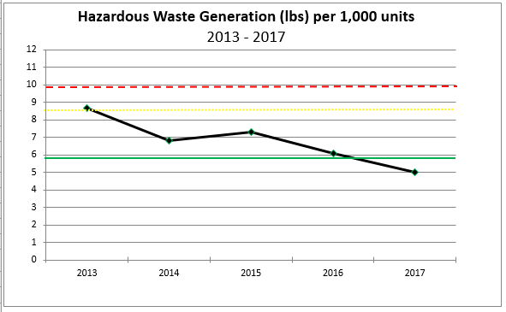
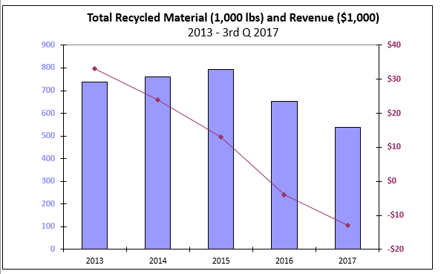
CHECK – Performance
KPI/Metrics
Example Only - Not Real Data
Example Only - Not Real Data
Control Zone
Opportunity
Is process out of control?

Slide 26
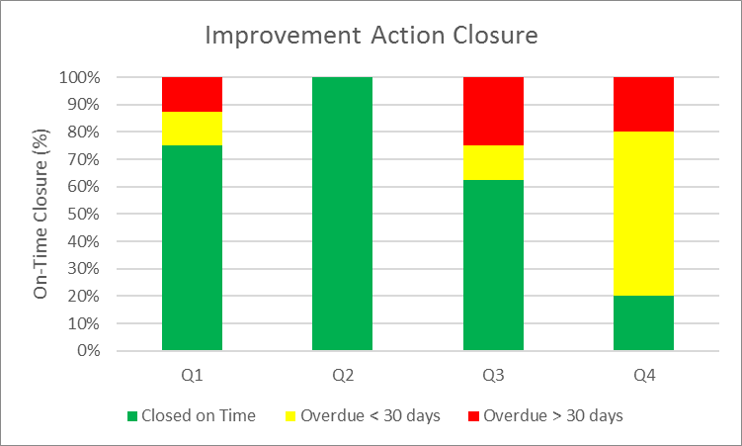
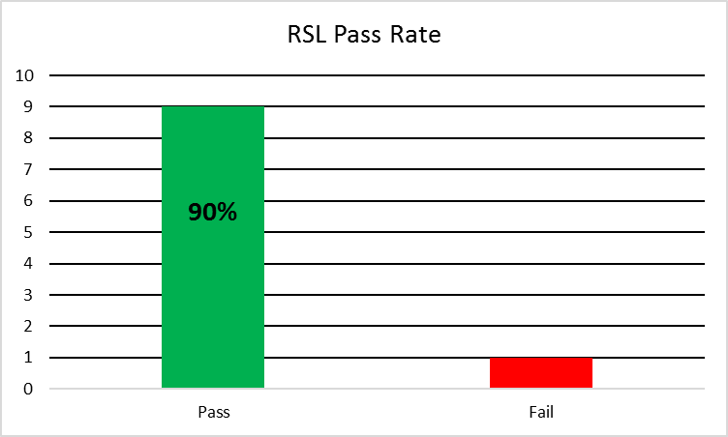
CHECK – Performance
KPI/Metrics
Example Only - Not Real Data
Example Only - Not Real Data
Key Performance Indicators (KPI)
Measure results – not just activity
(e.g.) 100% on-time closure or 100% Pass Rate

Slide 27
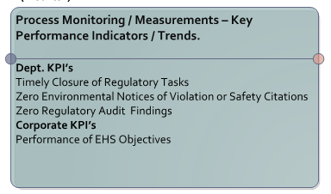
CHECK – Audit and Validation
Risk-Based Approach
KPI’s In Control?
Standardized Reviews (e.g. EHS, training, document/record control, calibration, interviews, etc.)

Slide 28
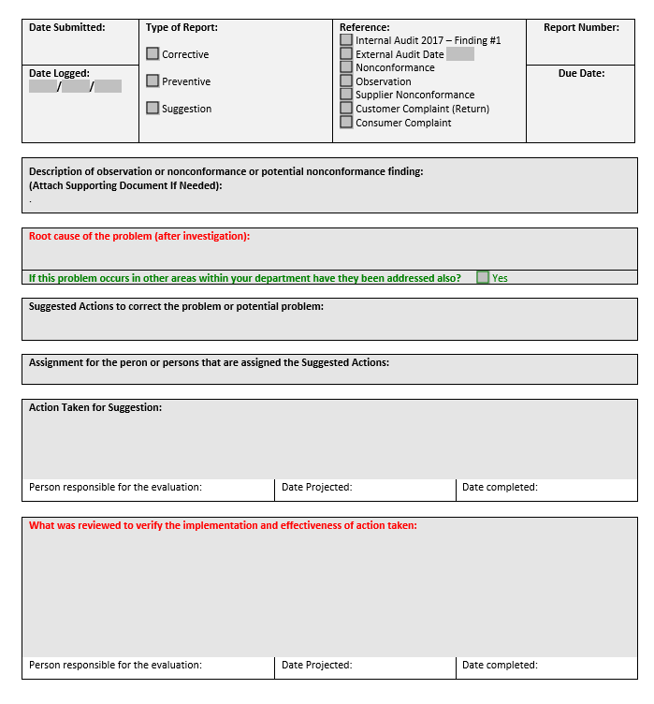
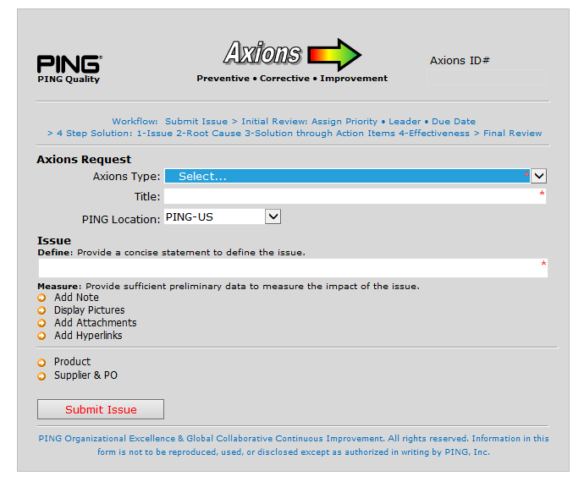
ACT – Improvements
Correct Root Cause?
Actions Effective and Sustainable?

Slide 29
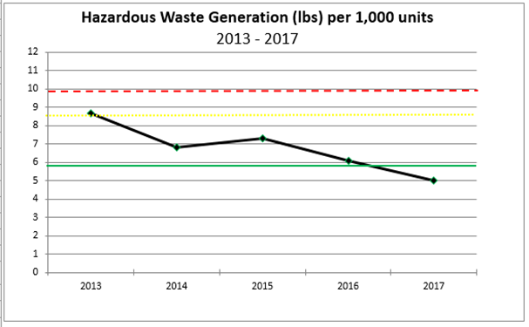

Report – Leadership
Meeting commitments?
Performance in control?
If not – what are you doing about it?
“I can handle bad news but I hate surprises”
New requirements?

Slide 30
PING, Inc.
Manage EHS/Compliance performance as a competitive advantage
Improve your effectiveness to the point where no one with the same assets can produce at a lower cost then you
Thank you!

